Slide 1
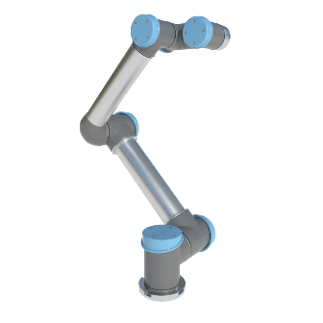
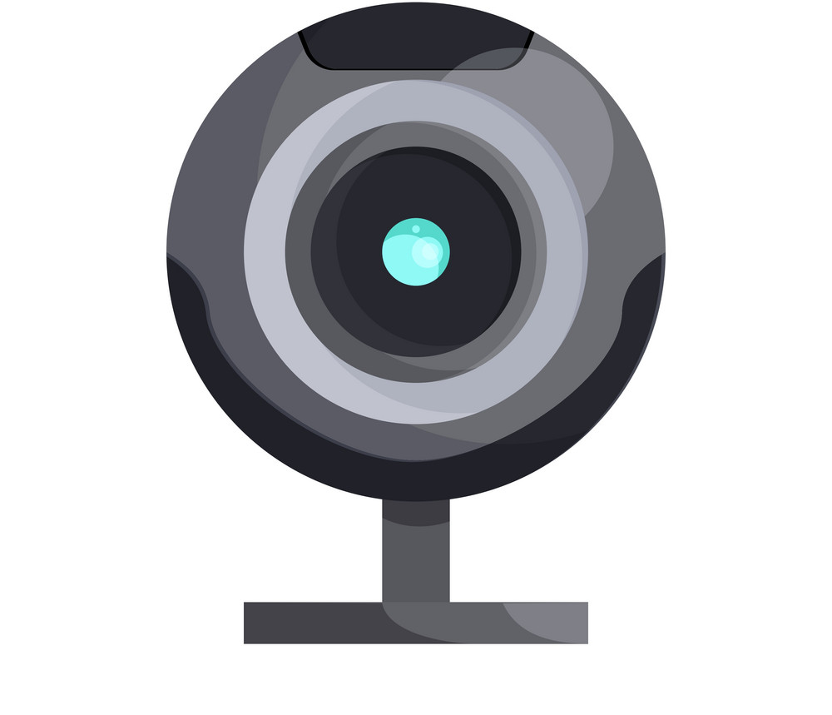
Vision Control Bot
Vision Control Bot
Team BJJ (Dajun Tao, Peize Hong, Shaobo Wang, Yicong Xiao)

Slide 2
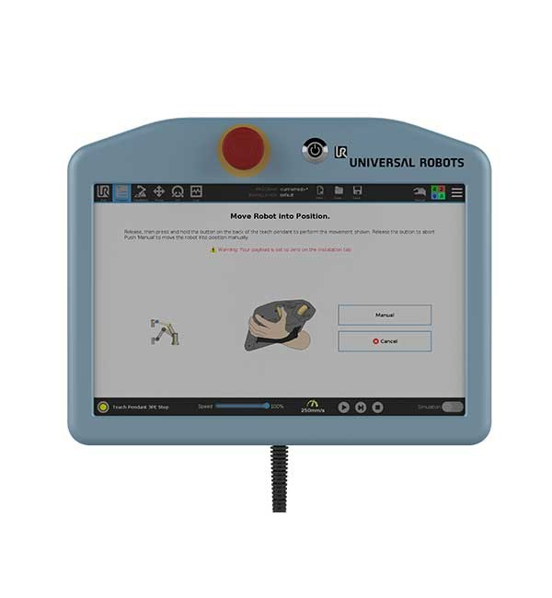
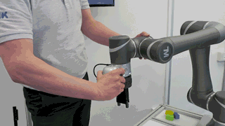
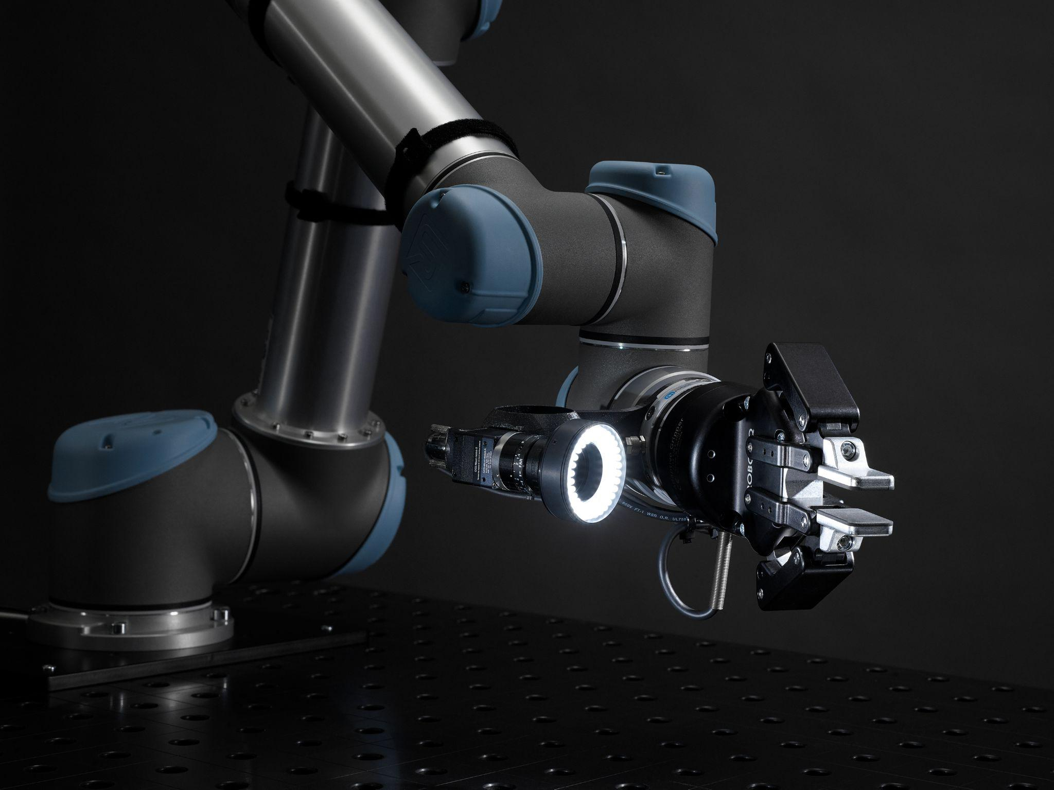
Problem Statement
Vision Control Bot
Ease Tedious Co-Bot Teaching Process
Traditional
Vision Control Bot
Teach Pendant Programming or Dragging Robot Around
Vision Based Real-Time Trajectory Tracking

Slide 3
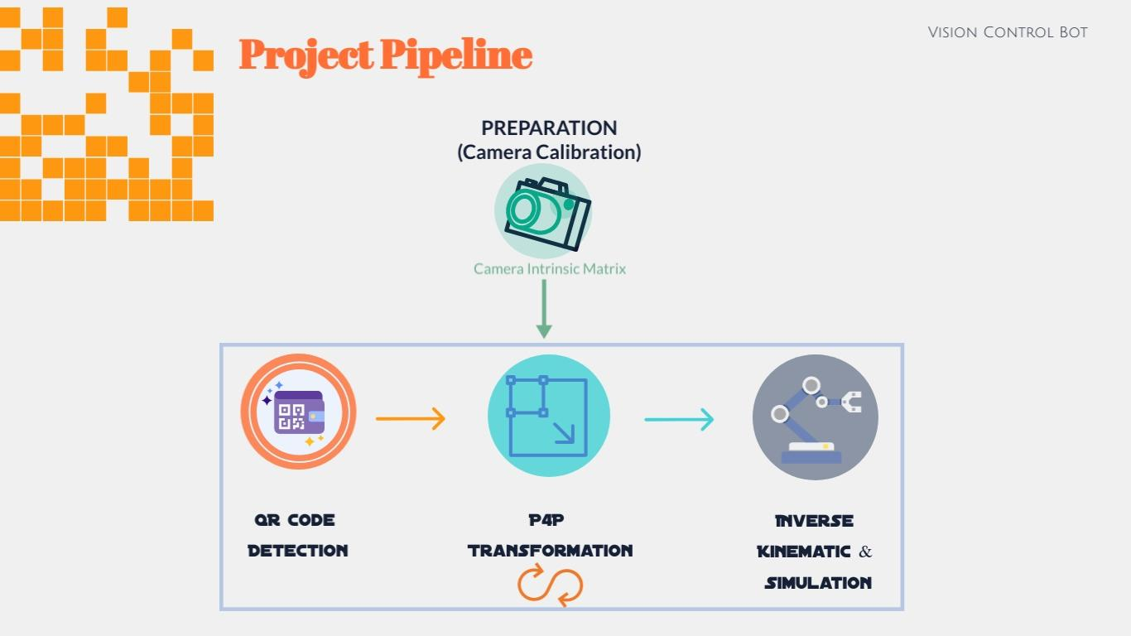

Slide 4
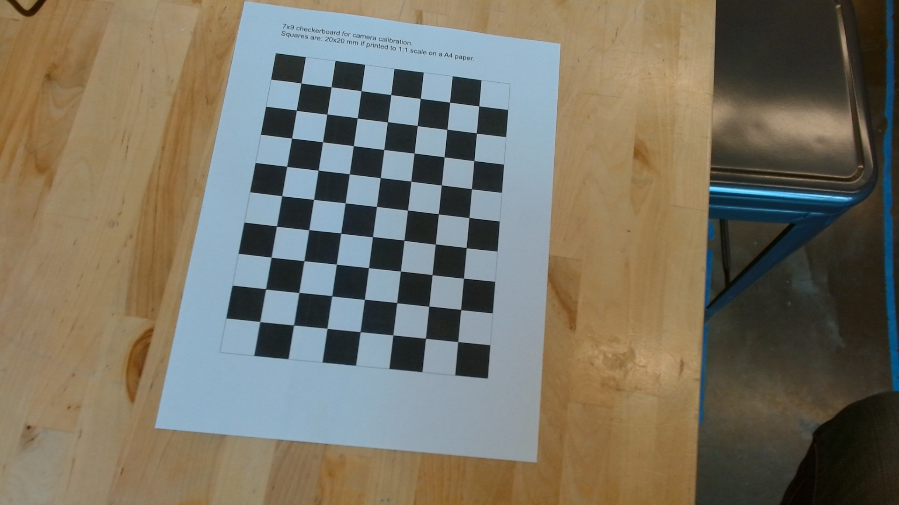
Camera Calibration - Intrinsic Parameters
Vision Control Bot
Objective:
Camera Matrix and Distortion Coefficient
Process (cv2.calibrateCamera()):
21 images of calibration board (extreme case)
Object Points: Physical Checkerboard Intersection Points
Image Points: Corresponding Points Pixel Location
Figure 1. Checker board

Slide 5
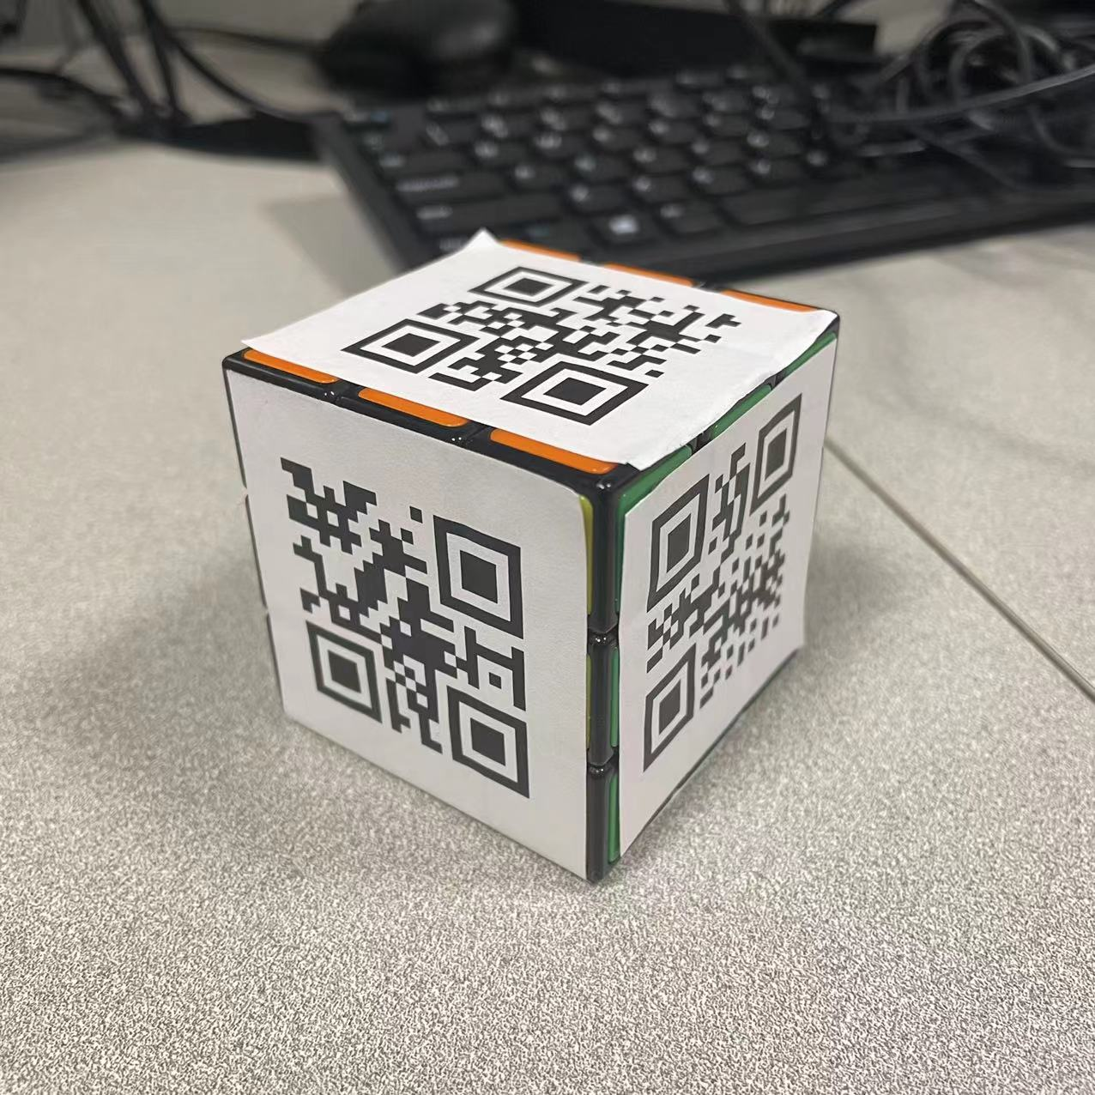
Hardware Setup
Vision Control Bot
Teaching Cube
57mm x 57mm Cube
Ensure Flat Surface For Accurate Edge Detection
Uniquely Encoded QR Code
Numerical Encoding (0 - 5 for 6 face)
Inform the Algorithm which Face It Is Looking At (For Later Rotation Angle)
Figure 2. Teaching Cube
Notes:
After camera calibration, our next step is to figure out the relative motion between the teaching object and the camera. The idea behind this project is that camera is fixed in the world frame, we are estimating the real-time teaching cube pose to form the trajectory of motion. It is very similar to camera pose estimation problem but, in our case, it is the cube that is actually moving. So, to perform PNP transformation we prepared a 57mm-by-57mm cube to ensure flat surface which will be beneficial for later QR edge detection. Each face of the cube is covered by one uniquely encoded QR code. It is just simple numerical encoding by numbering each face from 1 – 6. So, whenever the camera detects the cube, it knows which face it is looking at. It helps the algorithm to calculate the angle of rotation.

Slide 6
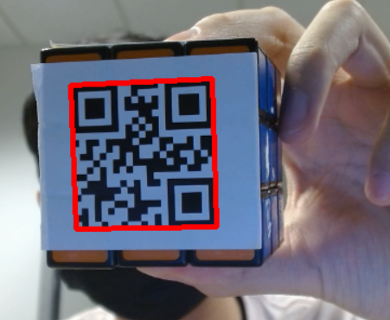
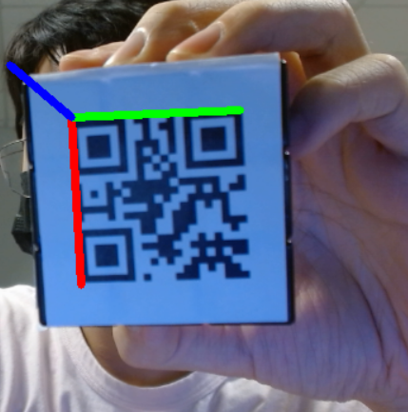
P4P Transformation
Vision Control Bot
Image Plane Coordinate
Four Corners of QR Code (P4P Input 1)
Opencv Function cv2.detectQR()
Object Coordinate
Origin at Top Left Corner of Face 1
Top Edge as X Axis, Left Edge as Y Axis, Z Axis Coming Out of The Screen (Figure 3)
Four Corner of QR Code (P4P Input 2)
Z
X
Y
Figure 3. QR Corner Detection
Figure 4. Object Coordinate Frame
Notes:
For our implementation, we used the traditional P4P transformation. First, to get our four points on image plane we tried two QR detection function from both PYzbar and OpenCV. We finally decided to go with OpenCV due to its floating-point accuracy compared to the integer accuracy in PYzbar. It returns the 2D coordinates of four corner points of the QR code on the image plane. Next, we defined the top left corner of the QR code on face 1 as origin (0,0,0), and X, Y, Z Axis as shown in the image. We then figured out the 3D coordinates of all remaining QR corners based on the physical dimension of each QR code under this object frame.

Slide 7
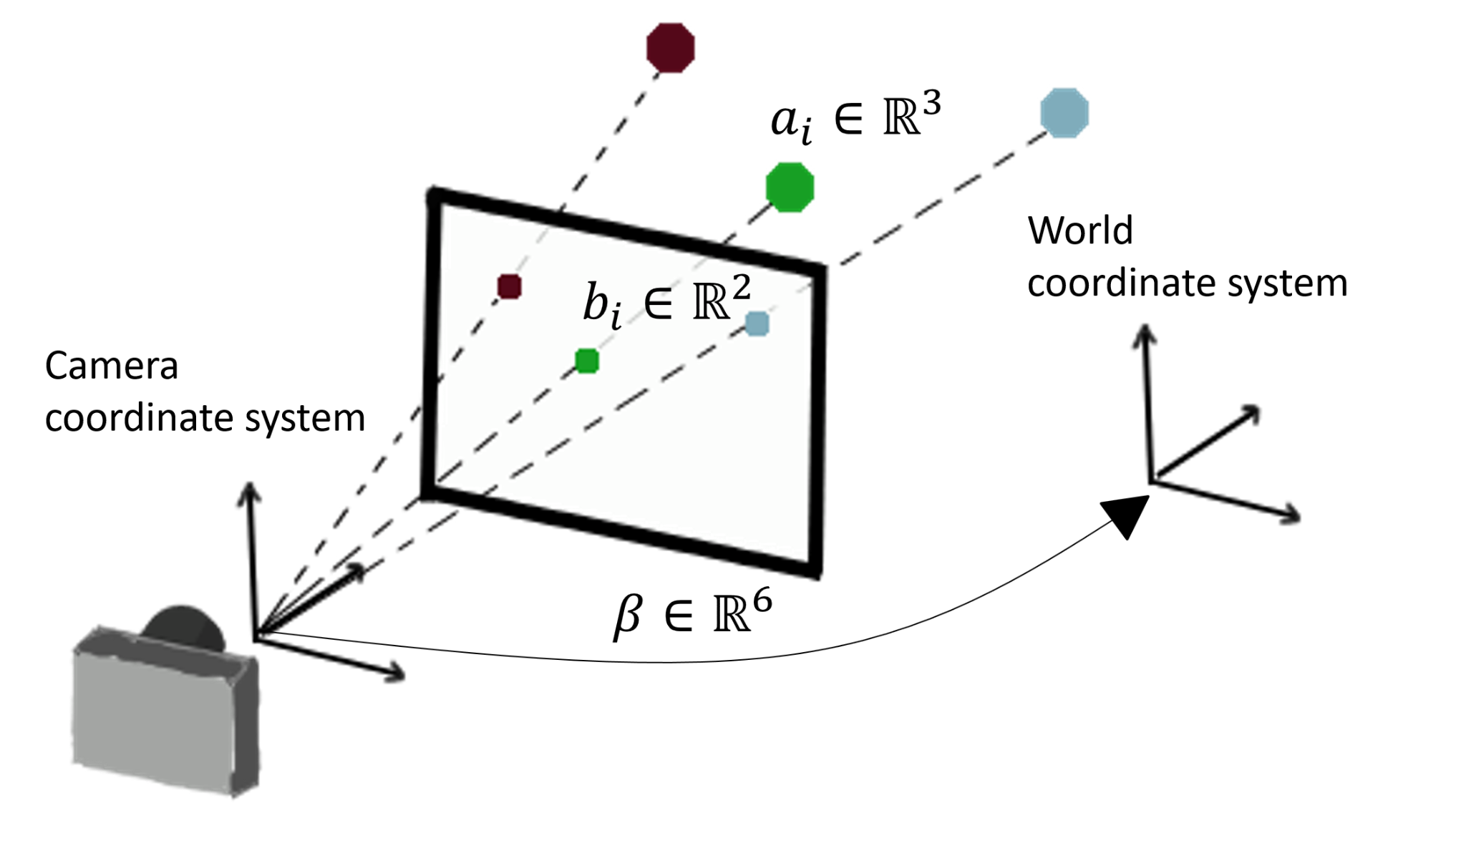
P4P Transformation
Vision Control Bot
Three Inputs For SolvePnp (cv.solvePnP())
Image Plane: Four Corners of QR Code (P4P Input 1)
3D Space: Four Corner of QR Code (P4P Input 2)
Camera Matrix (P4P Input 3)
Output
4 x 4 Homogeneous Transformation Matrix
Object Coordinate
Rotation Matrix to Euler (eul.mat2euler(-)
Rotation Matrix in Euler Angle Representation
Camera Coordinate
Figure 5. P4P Transformation
Notes:
So now we get all our inputs for OpenCV solve pnp function. Four points on the image plane, and their corresponding their 3D coordinates plus the camera matrix. We then feed it into solvepnp, The results of this P4P transformation are a 4 x 4 homogeneous matrix which transform the object frame to camera frame. As the final tweaking we used the opencv.mat2euler function to transfer all rotation angles to euler representation.

Slide 8
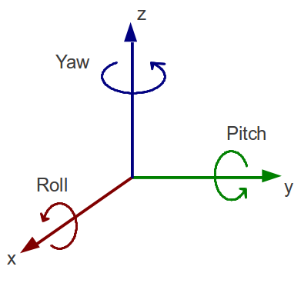
P4P Transformation Output
Vision Control Bot
Translation Matrix (3 x 1)
Translation Between Origins Of Two Coordinate Frame
Rotation Matrix (3 x 3)
We Later Transformed the 3 x 3 Rotation Matrix Into (Row, Pitch, Yaw) Representation For Robot Arm Simulation
Next Step
Object Frame to World (Robot Frame) Transformation
Figure 6. Row Pitch Yaw
Notes:
Next, we are dissecting the 4x4 matrix into a 3x1 translation matrix and a 3x3 rotation matrix. To prepare the input for later simulation, we further transferred our rotational matrix into row pitch yaw which are essentially the angle of rotation about each axis. However, the 3D transformation is still not done since the camera coordinate is not equivalent to the robot coordinate, so my teammate will walk you through our next step.

Slide 9
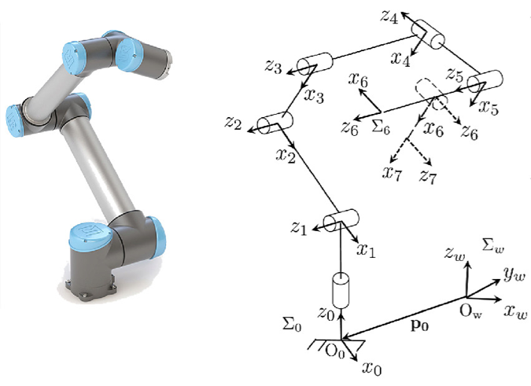
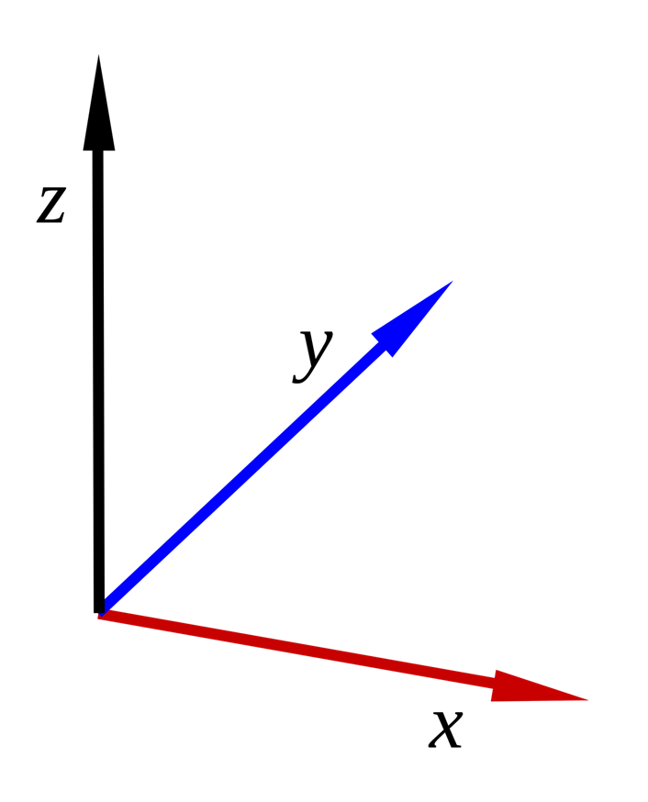
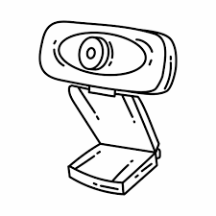
Kinematic Chain Overview
Vision Control Bot
?
Object
Frame
Stationary Frame
Camera
Frame
Notes:
Our goal in this project is to use the camera information to guide the operation of the robot arm to perform certain tasks. The thing we care about is the 3D position and orientation of the object, which can be used to compute the cobot’s control command later on. So how can we get the object pose?
The general idea behind this is a kinematic problem, where we can get the object pose base on the chain rule by using camera frame and the transformation from camera to the object.

Slide 10
Kinematic Chain Components
Stationary frame to Tool frame:
forward kinematic
Stationary frame to Camera frame:
known camera pose
Camera frame to Object frame:
PnP problem solution inverse
Tool frame to Object frame:
designed task process
Stationary Frame
g_sc
g_st
Camera Frame
Tool Frame
g_co
Object Frame
Notes:
For more information, we can describe this problem as a closed–loop kinematic chain shown on the right. This chain will help us to solve any unknown given the other three components. On the left path of this chain is a link we discussed in the last slide. The camera frame is predefined. The tool frame pose relative to the stationary frame can be computed using pnp. Originally, pnp are used to compute the camera pose with respect to the object. In this case, we just need to solve the inverse problem.
On the right hand side, the relation between tool frame and object frame can be defined in specific tasks. For example, when you want to fasten bolts or grip objects, the tool frame should follow certain motion in the task space. While, the simplest case would just be letting these two frames be coincide with each other. Last but not least, since we already know three of the components, we can solve for the pose for the tool frame. And we only need to solve another inverse kinematic and a path planning problem, then we can control the robot arm to move to desire pose with a desired trajectory.

Slide 11
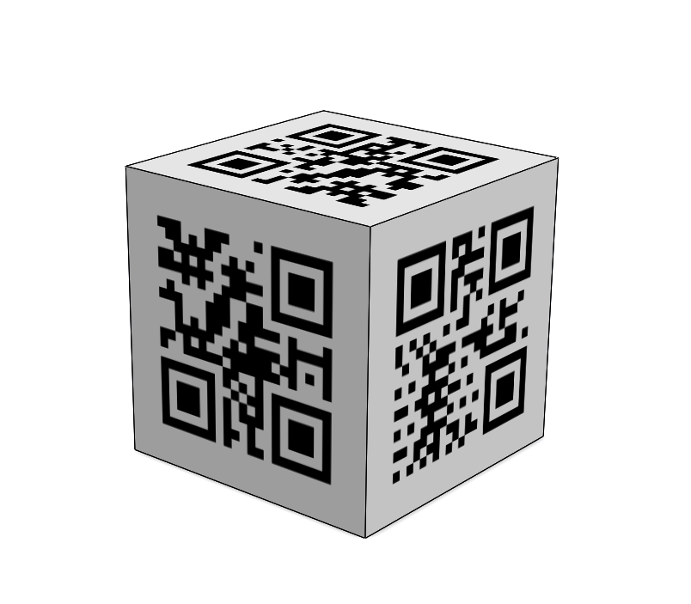
Object Center Pose
Table 1. Transformation LUT for each surface
“0”
 | x | y | z | rx | ry | rz
#0 | 0 | 0 | h/2 | 0 | 0 | 0
#1 | -h/2 | 0 | 0 | 180 | -90 | 0
#2 | 0 | -h/2 | 0 | 90 | 0 | 0
#3 | h/2 | 0 | 0 | 180 | 90 | 0
#4 | 0 | h/2 | 0 | -90 | 0 | 0
#5 | 0 | 0 | -h/2 | -180 | 0 | 0
“3”
“4”
Notes:
There is still a practical application detail for this problem. We now know we can get the object pose base on pnp. But it is in fact the pose of certain frame attached to each surface. To get the pose of the cubic object, we need to define the transformations from each surface to the center frame. This is represented in xyz and euler angle in the lookup table on the right hand side. This allows us to reconstruct the pose of object with any surface pointing at the camera.

Slide 12

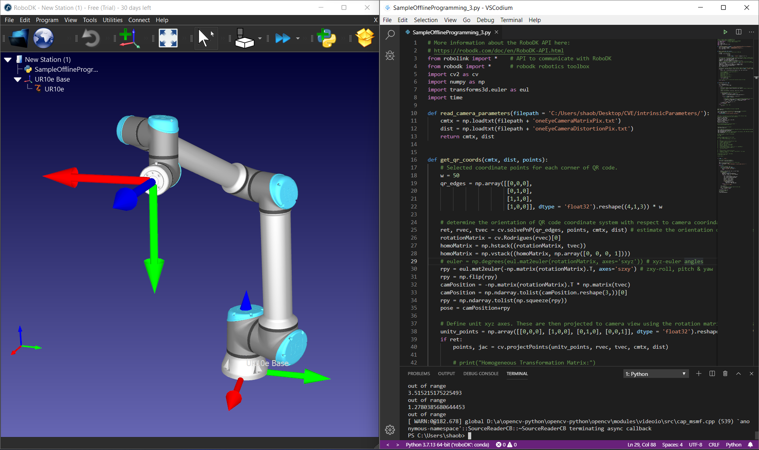
Vision Control Bot
Real-time robotic simulator
Directly take x, y, z, roll, pitch, yaw data from our CV program
Calculate Inverse Kinematic/Plan Trajectory
End effector moved with the unique solution
Tool frame
Inverse Kinematic
Stationary frame
Figure 7. RoboDK IDE Interface
Notes:
This is a simulation software we used in our project. It is called RoboDK IDE which we can import different types of robot manipulators. And we can use Python or C++ API to program our robot behavior. Here we only need to input the 6 coordinates data into our robot manipulator so it can move to where we want. So first we need to take the 6 coordinates from CV program and …
And also in the code, we use a while loop to keep it update in real-time and we design a filter to eliminate the noise and error measurement so our robot can have stable movement.

Slide 13
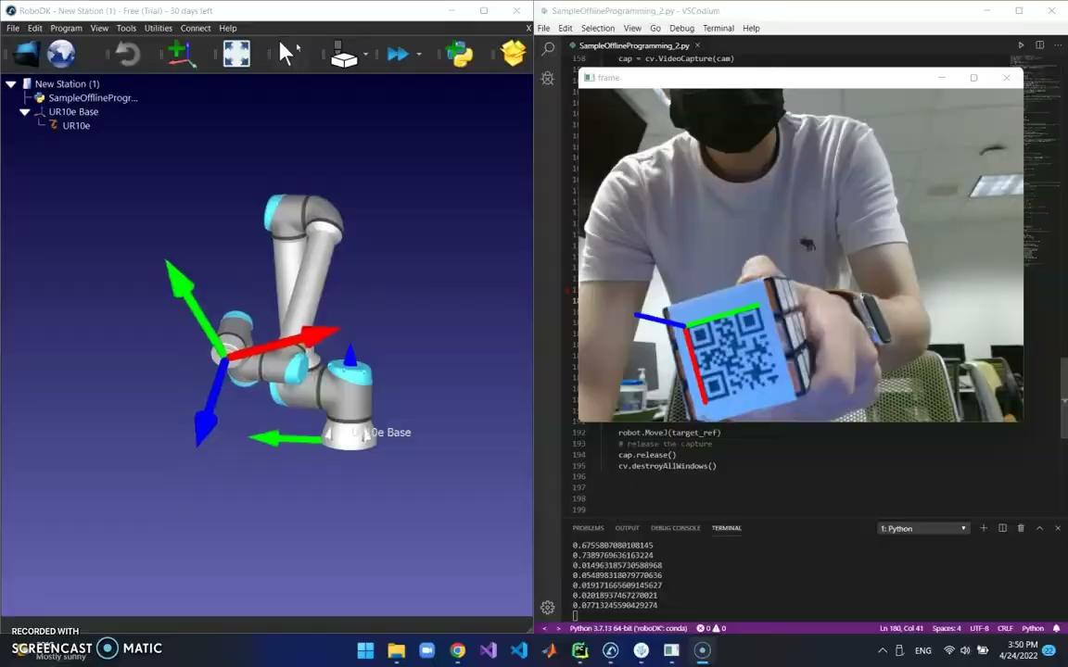
Video Demo
Vision Control Bot
Video1 . UR10e Industrial Robot
Real time simulation
Notes:
As you can see, it has quick responsiveness, and the movement is quite accurate for reflecting our movement. It can successfully execute x,y,z,roll yaw,pitch movement.

Slide 14
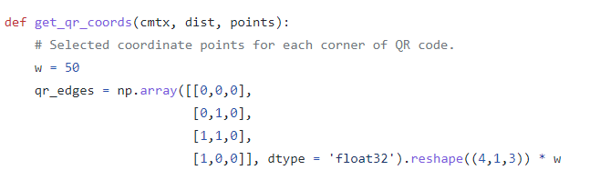
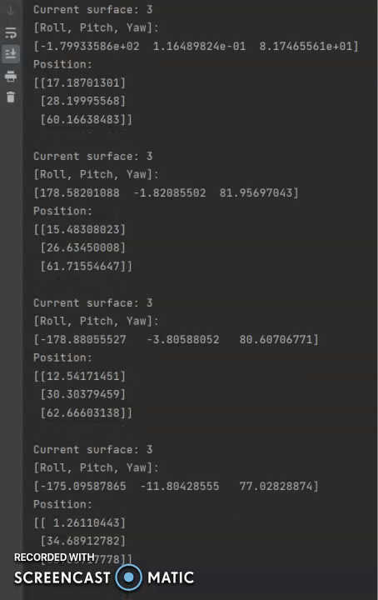
Sensitivity
Editable coordinate information
Vision Control Bot
Customized control track speed
Can save trajectory information (x, y, z, roll yaw, pitch) for later edit
Sensitivity factor
Figure 7. Source code screenshot
w: scale factor to real world motion
Figure 8. Trajectory txt. file screenshot
Notes:
Not only this, we take one more step forward. We also develop some useful functions
We can customize the control track speed by changing this value. That means we move the robot with faster speed. W is sensitivity factor also called scale factor to real world motion
Editable coord info: can save trajectory info in txt file and allow user to edit it later.

Slide 15
Future Goal
Vision Control Bot
Increase detection and rotation range
Optimize QR code detection successful rate
Use without QR cube & add hand gesture control
Notes:
In future practice, we still need to resolve the camera’s restricted field of view to allow larger range of motion detection.
Also, the QR code detection algorithm can be enhanced by using more efficient corner detection and feature extraction methods.
We believe it is also possible to use specific hand gripping gestures to replace the QR code in this case by utilizing machine learning methods.

Slide 16

Vision Control Bot
Any Questions?

